Slide 1
Music Classification
A Deep Neural Network for Classification and Identification of several music genres.

Slide 2
Meet the Team
Naman Singh Rana
-200050083
Parekh Dhairya
-200050097
Aditya Kadoo -200050055
Utkarsh Pratap Singh -200050146

Slide 3
Table Of Contents
Overview
Project objective
Real world application
Dataset Used
Architecture of the Network
Training the Model
Accuracy of our Model

Slide 4
Overview
With today’s cutting edge technology and intractable access to voluminous data files via the internet, it is important to meet the computational needs of every user. Machine learning is one such growing branch of artificial intelligence that has made such demands of the users viable. Machine learning models are paving the way for classification techniques such as in music genre classification, and have shown to be efficient in predicting classes to a great extent.
We have experimented with many possible variations of the models that are possible for accomplishing the task of classification. The major 5 types of models used are: 1. Feed Forward Neural Network 2. Support Vector Machine 3. K - Nearest Neighbour 4. Long Short Term Memory 5. Convolutional Neural Network + Feed Forward Neural Network

Slide 5
Project objective
The objective of this project is to experiment with different model architectures to find a better model for the problem statement of classifying a music into the 10 recognized genres. The input given to the model is a n-dimensional feature vector, where features are extracted from the music.

Slide 6



Real world applications
The application is very important and requires automation to reduce the manual error and time because if we have to classify the music manually then one has to listen out each file for the complete duration. The model can have applications in various industries like: Music Productions Music Streaming Platforms Music Editors

Slide 7
Dataset Used
The GTZAN dataset consists of 1000 music files in .au format for ten genres, with 100 files belonging to each genre. Every audio file is 30 seconds long falling under one of the ten genres:
Hip-Hop Rock Reggae Classical Jazz Blues Pop Disco Country Metal

Slide 8
Feature Engineering
We have engineered out 29 features for each music clip based on the references used and domain knowledge. Some noteworthy features out of these 29 features are: 1. Zero Crossing Rate - Represents number of times the amplitude wave cross x-axis 2. Tempo - The speed or pace of a given piece 3. MFCC - Widely used technique for recognizing phones 4. Some Other features used are RMS, Spectral Centroid, Spectral Bandwidth, Spectral Rolloff and Harmonic
ZCR
Tempo
MFCC
Feature Engineering
Our Model
Music
RMS
Genre
Spec Centroid
Spec Bandwidth
Spec Roll Off

Slide 9
Architecture of the Neural Network
The architectures of the several models are as follows:
Feed Forward Neural Network 4 Linear Layers with the in between activation function of tanh
Support Vector Machine Standard svm models with 4 different kernel functions, namely linear, polynomial, RBF and sigmoid.
K- Nearest Neighbours
Long Short Term Memory 3 layers with 100 hidden units followed by Fully Connected Network.
Convolutional Neural Network 1-D convolution layer was added before the FFN mentioned in 1.

Slide 10
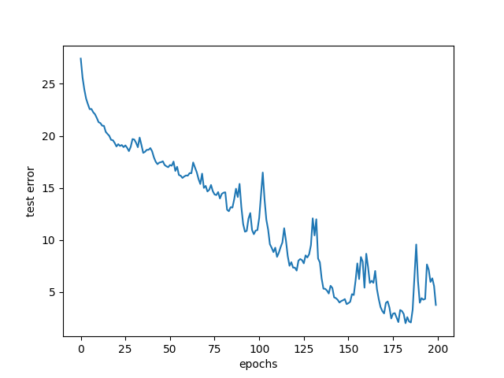
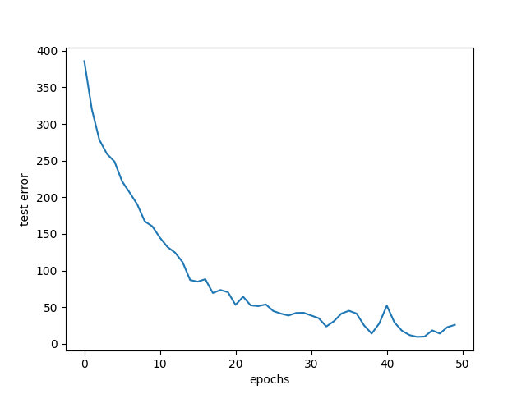
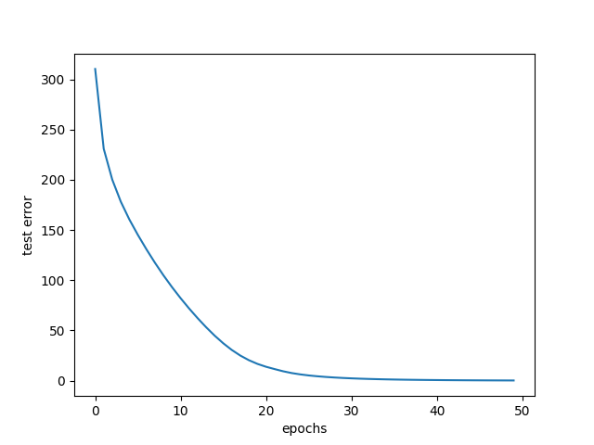
Training the Model
We have trained our model with the Cross Entropy loss functions. The value of loss plotted against the epochs for neural network is as follows:
LSTM
CNN-FFN
FFN

Slide 11
Accuracy of our Model
The accuracy of various models tried out by us during the experiments are as follows:
68%
75%
72%
71%
50%
CNN-FFN
FFN
KNN
SVM-Polynomial
LSTM
67%
71%
47%
SVM-Linear
SVM-RBF
SVM-Sigmoid

Slide 12
Confusion Matrices

Slide 13
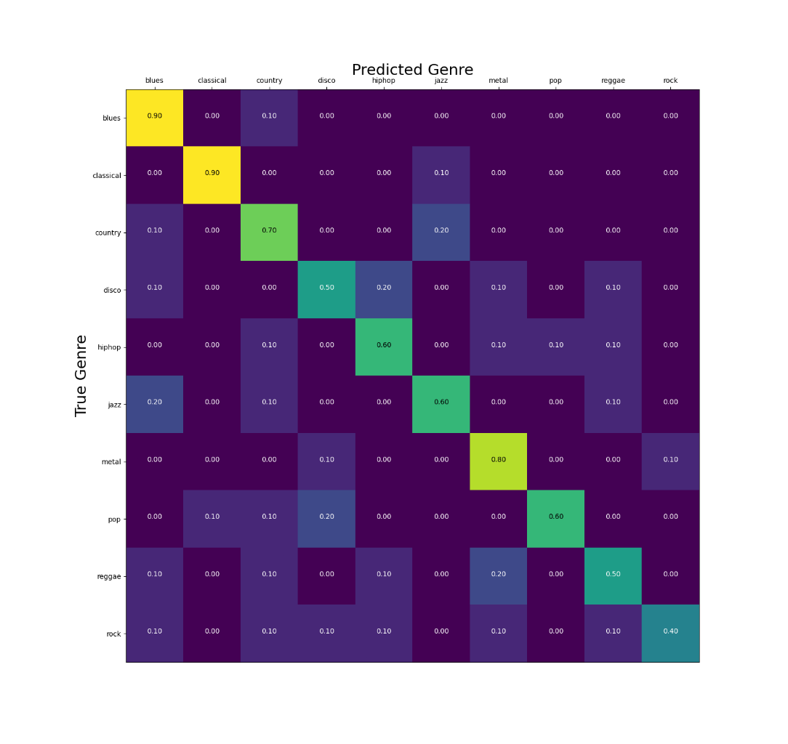
CONFUSION MATRICES
FFN

Slide 14
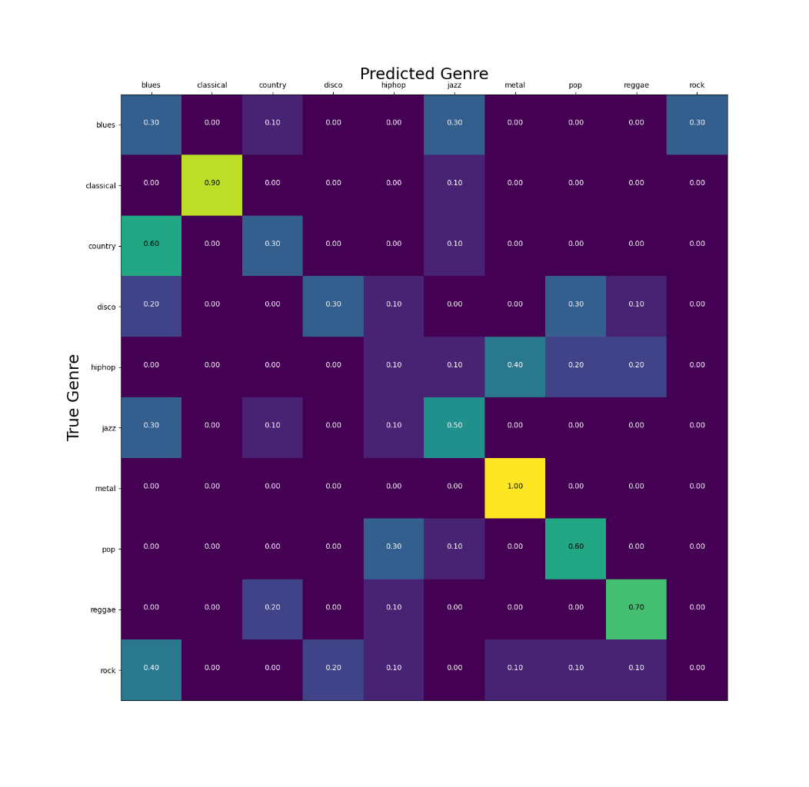
CONFUSION MATRICES
SVM

Slide 15
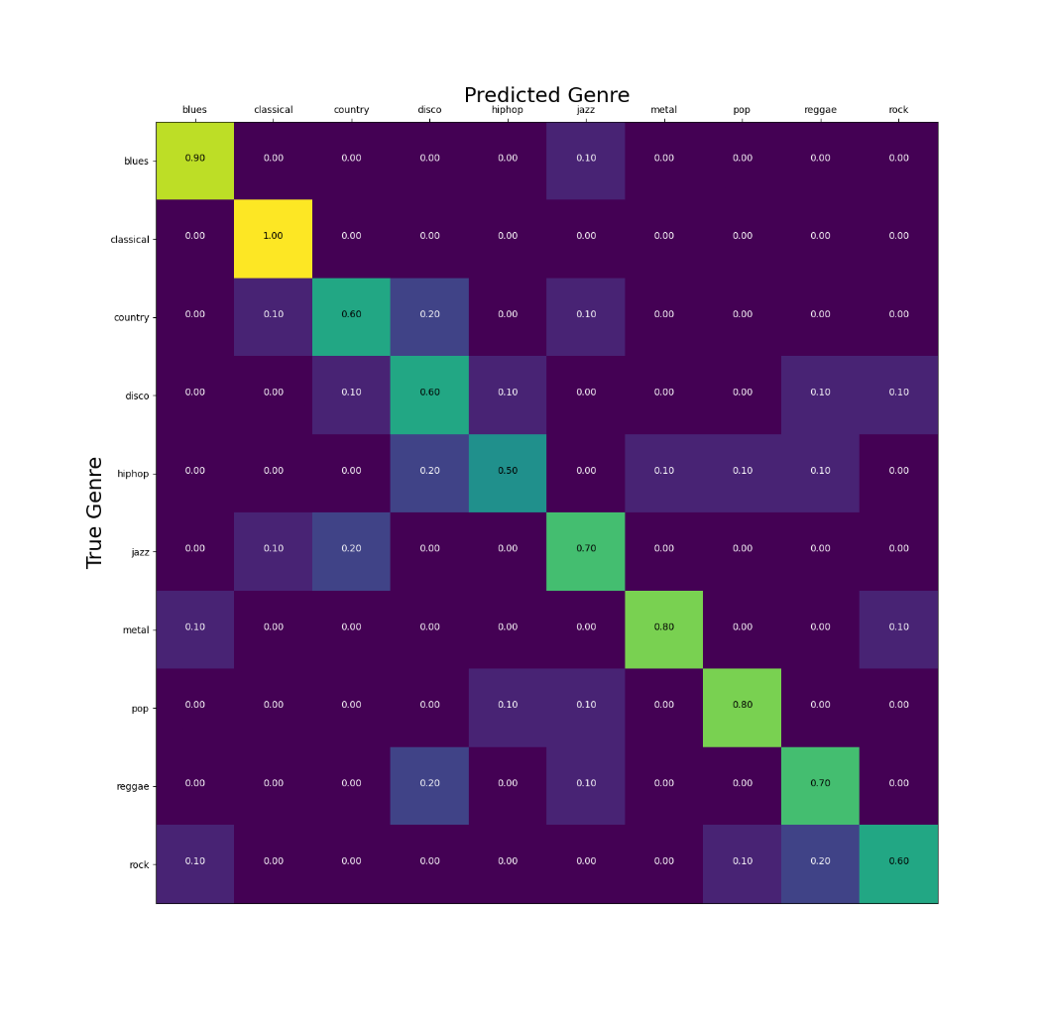
CONFUSION MATRICES
KNN

Slide 16
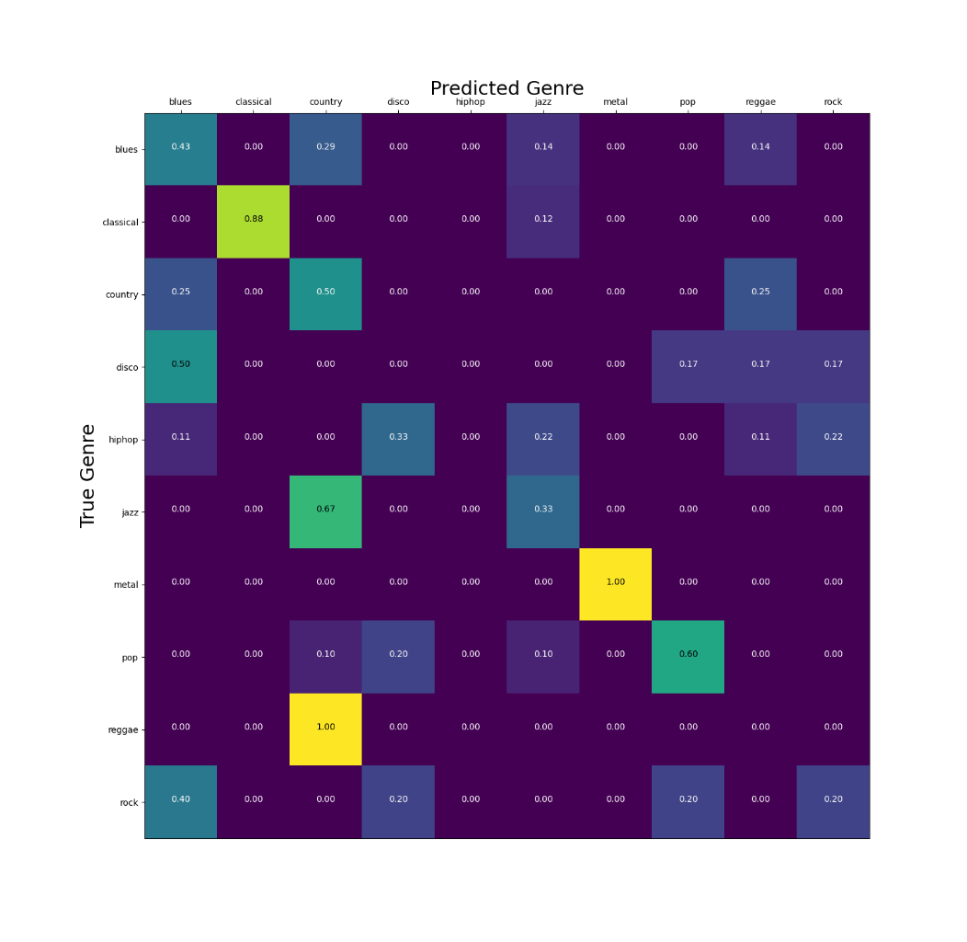
CONFUSION MATRICES
LSTM

Slide 17
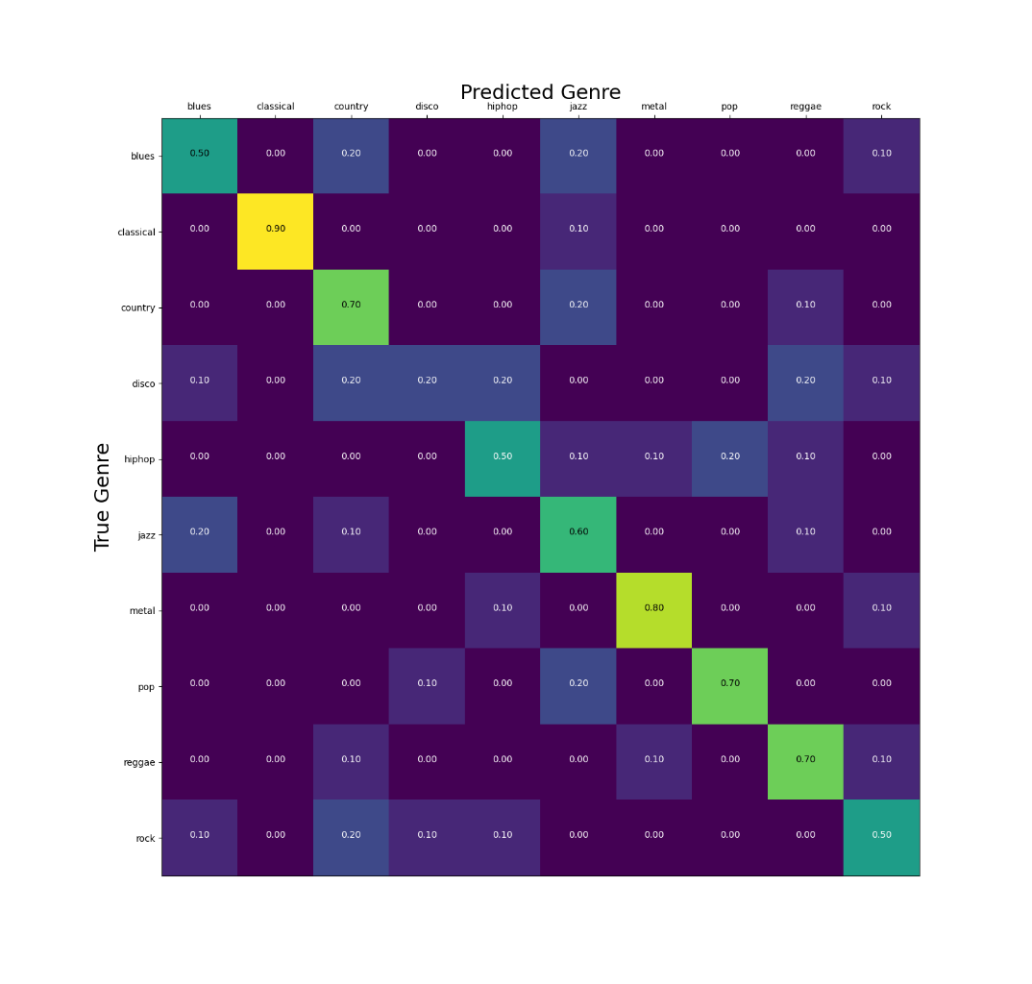
CONFUSION MATRICES
CNN-FFN

Slide 18

Thank you!
We sincerely hope you enjoyed our presentation…

